Slide 1
Test Oracles
By: Mounika Kiran Eluri : 40055028
Natasha Basutkar : 40081017
Pushpinder Virdi : 40071240
Uday Amrinder Singh : 40071019

Slide 2
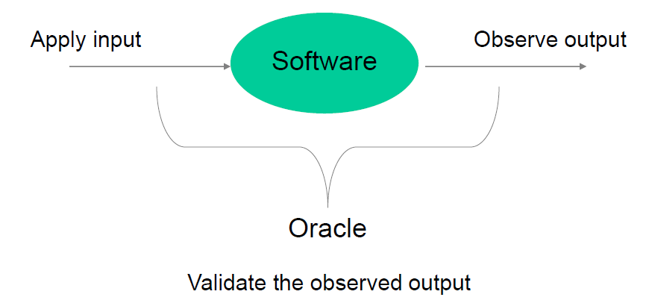
Introduction
Test oracle : A test oracle distinguishes whether a test case behaviour is correct or incorrect.
This paper focuses on how test oracles can be automated along with the understanding of different types of oracles, their evolutions over time and further progress on how we can automate test oracles.

Slide 3

Problem statement & Motivation
As of today, there is no automated solution to the test oracle problem.
The work on test oracle problem in Binder’s Textbook in 2000 and work on automated test oracles for functional properties by Pezze and Zhang in 2014 has provided motivation to this paper.
Hence, we need a formalized procedure to differentiate the actual output from the observed output for System Under Test (SUT).

Slide 4
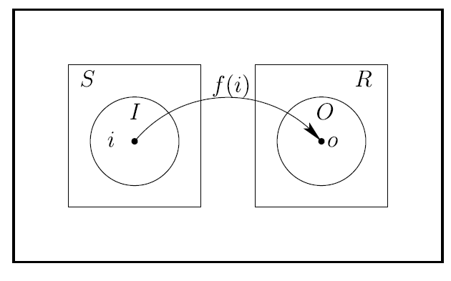
Terminology related to test oracles
Test activities: For the SUT p, S is the set of stimuli that trigger or constrain p’s computation and R is the set of observable responses to a stimulus of p. S and R are disjoint. Test activities form the set A = S U R.
Test activity sequence: It determines following the constraints such that it can be utilised in the system. The sequence also simplifies the test case execution by directing the testers to satisfy the required constraints.
Partial test oracle : These can be constructed when there are no full specification of properties using metamorphic testing.
Probabilistic test oracles: A probabilistic test oracle Ď : T_{A} →[0,1]maps a test activity sequence into the interval [0,1] ϵ R. This helps in modeling the case where the test case only offers an acceptable test case probability.

Slide 5
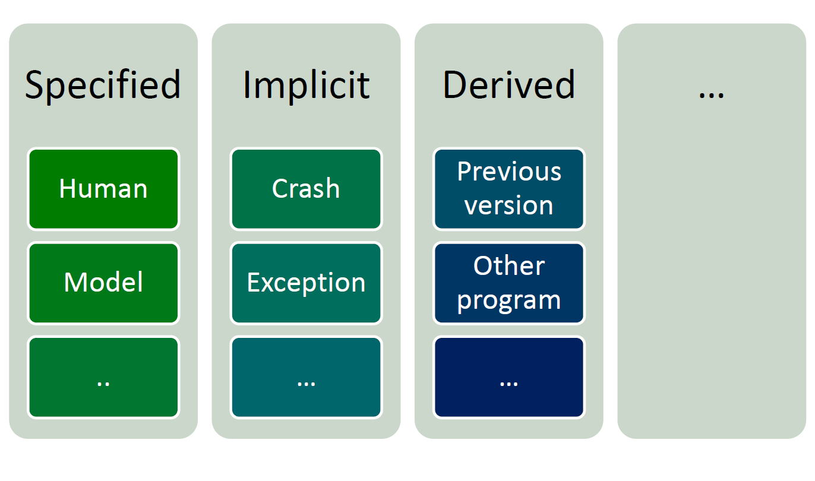
Types of test oracles
Specified test oracles: Test the behavioral characteristics for a given set of detailed specifications in a system.
Derived test oracles: They consider components from which a test oracle can be extracted such as preceding version of the testsystem. An oracle is derived from development artifacts or system execution.
Implicit test oracles: This type of oracles are very straightforward as they look for evident faults in the test system.An oracle judges behaviour using properties expected of many programs.
Human Oracles: Human Test oracle deals with the lack of a test oracle.

Slide 6
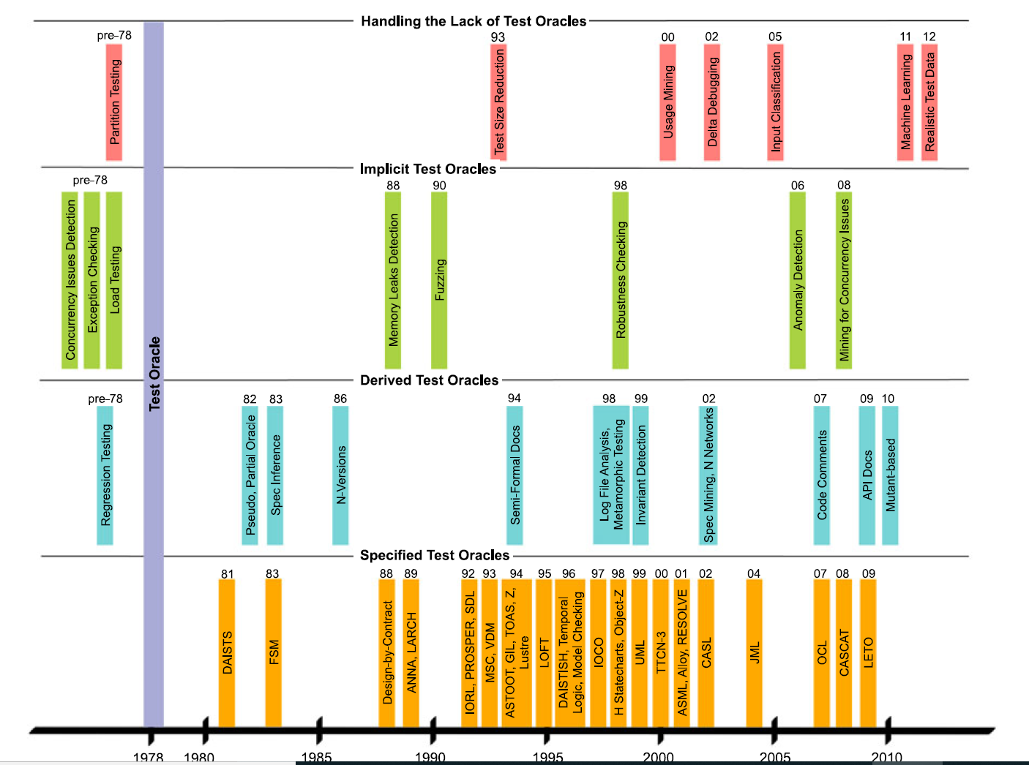
Evolution of test oracle techniques

Slide 7
Evolution of test oracle techniques explained…
Every vertical bar represents the test oracle technique along with the concept used labelled against the year it was published.
For instance, the study on Finite State Machines was carried out as early as in 1950s however the actual use of FSM was made in the papers written by ‘Jard and Bochmann’ and ‘Howden’.
Pre-1978: concepts and technical developments that lead to the creation on test oracles such as detecting deadlocks, live locks as part of ‘Concurrency detection’ and conducting performance type of testing such as Regression/Load testing.

Slide 8
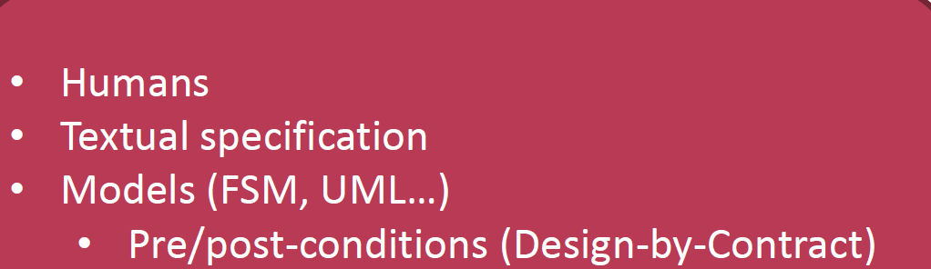
Specified test oracles
These oracles are associated with formalised approaches to software modelling.
They are connected to formal specification model-based design which may be used to generate test oracles.
Textual Specifications
Model
Specified Test Oracles have a number of drawbacks. Formal specification relies on abstraction, as we know all models cannot capture all behavior.

Slide 9

Specified Test Oracle Challenges
Absence of formal specifications that affects test oracle generations for a few cases but not all.
Imprecision in capturing the required behaviour while checking for a specification.
Difficulties in interpreting model output as concrete program output.

Slide 10
Derived test oracles
Derived test oracle : A derived test oracle separates correct and incorrect behavior by using information derived from artefacts of the system.
Pseudo-Oracles :Also called N-Version programming, where multiple designs are implemented, or same design is implemented by independent teams
Metamorphic Relations:-Change in input also “changes” the output. To test programs without the involvement of an oracle; we employ properties of the target function known as metamorphic relations
Regression Test Suites:-A regression test suite is the set of test situations that are intended to guarantee that product is exact. Each level of testing ought to have its very own regression test suite.
Textual Documentation:-Documentation also serves as an oracle in a way that it describes the functionalities expected from SUT. These are actually informal. They are also partial, unambiguous in contrast to specification languages.

Slide 11
Implicit test oracles
Implicit oracle can be applied to check the specification that can be expected from any runnable program.
Implicit oracles can be built to detect Concurrency Issues - Deadlock, live lock, and violations related to non-functional attributes of the system like:
Performance properties
Robustness
Memory access and leaks.
Fuzzing is an effective way to find a crashes. Fuzzing is used to detect buffer overflows, denial of service etc.

Slide 12

Human oracle problem
Human oracle cost reduces human involvement in two dimensions such as writing test oracles and evaluating test outcomes.
Quantitative reduction in the amount of work the tester has to do for the same amount of fault-detection potential.
Qualitative reduction increase in the ease of evaluating and understanding test cases.
Crowdsourcing the Test Oracle: Crowdsourcing is performed by submitting tasks to generic platform such as Amazon Mechanical Turk and also crowd should be able to provide sufficient documentation and should determine the correct output from the incorrect ones.

Slide 13

Paper critiques
Building test oracles based on older versions of the system and sharing of oracular data are two of the promising approaches for test oracle reuse.
Positives:
The paper provides insight on how test oracles have evolved in the past (Software Evolution).
The paper proposes different metrics to quantify test oracles (Software Metrics).
Negatives:
The paper does not provide a proposed theoretical solution to the oracle automation problem.
The paper does not explore the power of AI to address test oracle automation

Slide 14
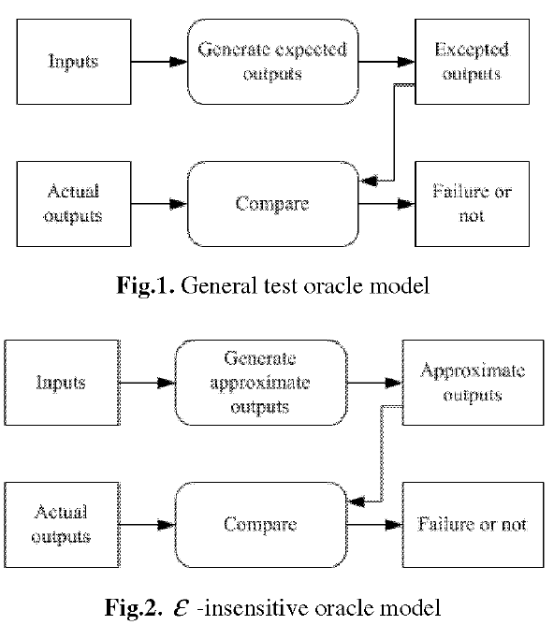
Emerging Research Ideas
To develop an automated test oracle, we must make sure the expected output is generated and compared with actual output automatically.
We can store the results in a database and perform a simple lookup, create state transition system such as FSM or simply evaluate the results against Boolean expressions.
Research has shown that neural networks can be used to test software and act test oracles with acceptable degree of accuracy.
The significance of neural networks lies in its approach to behave as a test oracle and predict the outputs of a system without having prior knowledge of the system.

Slide 15

Lessons learned & Conclusion
We have learned what is automation of test oracle, the working of test oracles and how the research is progressed.
How different languages have been implemented using test oracles.
What are the partial test oracles, test oracles re-use and test oracle metrics solutions that have been proposed for the test oracle automation problem but not a complete solution.
Emerging research directions such as neural networks that compares the generated approximate output with the observed output.

Slide 16


Slide 17
References
1) The Oracle Problem in Software Testing: A Survey. (2015). [online] Available at: https://ieeexplore.ieee.org/document/6963470 [Accessed 30 Jul. 2019].
2) Automated Test Oracle Based on Neural Networks. (2006). [online] Available at: https://ieeexplore.ieee.org/document/4216456 [Accessed 30 Jul. 2019].
3) Topic 4-6260 2019 (1 slide)

